Slide 1
Chapter 1:
Introduction to Computers and Programming

Slide 2
Why Program?
Computer – programmable machine designed to follow instructions
Program – instructions in computer memory to make it do something
Programmer – person who writes instructions (programs) to make computer perform a task
SO, without programmers, no programs; without programs, a computer cannot do anything

Slide 3
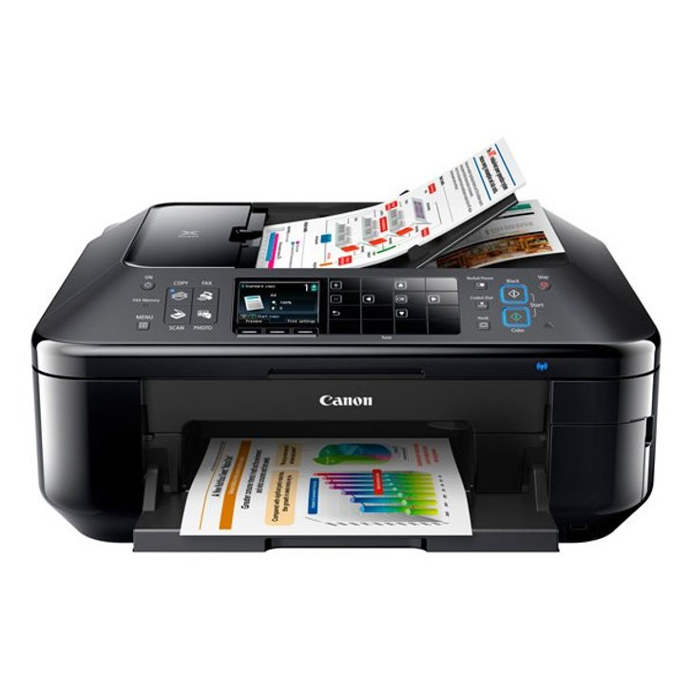
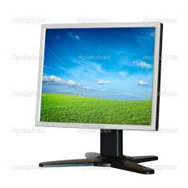
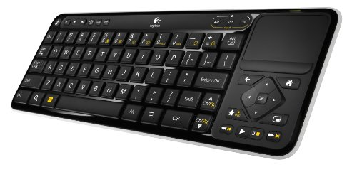

What is a Computer?
A device that can store, retrieve and process data
Input device
Central Processing Unit
Output device
Control Unit
Arithmetic/logic Unit
Auxiliary storage device
Memory Unit
The von Neumann architecture:
data and instructions are logically similar and
could be stored in the same place

Slide 4
How Computers See Data (or Instructions)?
Binary (base 2): 0s and 1s
110110 = 1×2⁵ + 1×2⁴ + 0×2³ + 1×2² + 1×2¹ + 0×2⁰ =54
Converting from base 10 to base 2
Divide by 2, keep the reminders
8 bits = 1 byte
2 (or more) bytes = 1 word
0 | 0
1 | 1
2 | 10
3 | 11
4 | 100
5 | 101
6 | 110
7 | 111

Slide 5
How Computers See Data (or Instructions)?
Characters: ASCII codes
Hello World!
010010000110010101101100011011000110111100100000010101110110111101110010011011000110010000100001
A | 65 | 01000001
B | 66 | 01000010
C | 67 | 01000011
D | 68 | 01000100

Slide 6
Memory
Memory: A collection of cells, each with a unique address
8-bit address ➔ 2⁸=256 cells
Contents of 00000010
instruction/data/part of an image
Address | Contents
00000000 | 11100011
00000001 | 10101001
00000010 | 11000110
11111100 | 00000000
11111101 | 11111111
11111110 | 10101010
11111111 | 00110011
7 | 6 | 5 | 4 | 3 | 2 | 1 | 0
1 | 0 | 1 | 0 | 1 | 0 | 1 | 0
Bit position
Contents

Slide 7
Control Unit
Controls the actions of the other components, to execute instructions in sequence
Address | Contents
00000000 | 11100011
00000001 | 10101001
00000010 | 11000110
11111100 | 00000000
11111101 | 11111111
11111110 | 10101010
11111111 | 00110011
Program counter (PC)
Contains the address of the next instruction to be executed
IR:
10101001
Instruction Register (IR)
Contains the instruction currently executed
PC:
00000010

Slide 8
How do Computers Work?
FETCH CYCLE
Registers
EXECUTION CYCLE
Control unit
ALU
(2) Decode instruction
(3) Get data
(1) Fetch instruction
(4) Execute instruction
Main Memory

Slide 9
Solving Problems with a Computer
Telling a very fast moron exactly what to do
Analysis and Specification
Clearly written problem statement
Algorithm Development
Plan for the general solution
Implementation
Working computer program
Maintenance

Slide 10
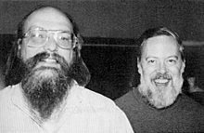
Origins of C/C++
UNIX rewritten in C
International Group
Ken Thompson
Bjarne Stroustrup
ISO/IEC Standard
ALGOL
1967
B
1973
C
C++
1999
C11
1960
BCPL
1970
C
1979
C99
2011
Martin Richard
Dennis Ritchie (Bell Labs)
ISO/IEC Standard

Slide 11
C/C++ Based Languages
C++ includes all the features of C, but adds classes and other features to support object-oriented programming.
Java is based on C++ and therefore inherits many C features.
C# is a more recent language derived from C++ and Java.
Perl has adopted many of the features of C.

Slide 12
Why C/C++?
The C/C++ language is the bedrock of modern computing
C/C++ language
Efficiency
Portability
Standard library
Flexibility
Power
Integration with Unix
Low-level
Small
Permissive
error-prone
difficult to understand
difficult to modify

Slide 13
Some Well-Known Programming Languages
C++
BASIC
Ruby
Java
FORTRAN
Visual Basic
C#
Swift
COBOL
Rust
JavaScript
C
Python
Go

Slide 14
A simple program

Slide 15
Program: Printing a Pun
#include <iostream>
using namespace std;
int main(void)
{
cout << "To C++, or not to C++: that is the question.\n");
return 0;
}
This program might be stored in a file named pun.cpp
The file name doesn’t matter, but the .cpp extension is often required.

Slide 16
Compiling and Linking
C/C++ program
Executing a program:
Preprocessing. The preprocessor obeys commands that begin with # (known as directives)
Compiling. A compiler translates then translates the program into machine instructions (object code).
Linking. A linker combines the object code produced by the compiler with any additional code needed to yield a complete executable program.
The preprocessor is usually integrated with the compiler.
Preprocessor
Modified C++ program
Compiler
Object code
Libraries
Linker
Executable program

Slide 17
Compiling and Linking Using G++
GCC/G++ is supplied with Linux but is available for many other platforms as well.
% g++ pun.cpp
By default the executable is called a.out
To choose a particular name for the executable program
% g++ -o pun pun.cpp

Slide 18
The General Form of a Simple Program
pun.cpp
comments
// This program prints a message
#include <iostream>
using namespace std;
int main(void)
{
cout << “Hello World!\n";
return 0;
}
directives
main function
statements

Slide 19
Directives
Before a C/C++ program is compiled, it is first edited by a preprocessor
Commands intended for the preprocessor are called directives
e.g.
#include <iostream>
<iostream> is a header containing information about C++’s standard I/O library
No special marker at the end
Always begin with #

Slide 20
Functions
A function is a series of statements that have been grouped together and given a name
Library functions are provided as part of the C++ implementation
A function that computes a value uses a return statement to specify what value it returns
int sum (int a, int b)
{
return a + b;
}

Slide 21
The main Function
#include <iostream>
using namespace std;
int main()
{
cout << “Hello, CSC131!\n";
return 0;
}
Mandatory: is automatically called when program is executed
If no value is returned, compilers will give warning message
Status code; 0 indicates normal program execution

Slide 22
Statements
A statement is a command to be executed when the program runs
#include <iostream>
int main()
{
cout << “Hello, CSC131!\n";
return 0;
}
Directives do not end with a semicolon
End with a semicolon
return statement

Slide 23
Printing Strings
The cout displays a string literal
#include <iostream>
using namespace std;
int main(void)
{
cout << “Hello, CSC131!\n";
return 0;
}
Quotation marks are not printed
String litteral
\n: newline character is needed to advance to a new line

Slide 24
Comments: Multiple Styles
/* Name: pun.cpp
Purpose: Prints a bad pun.
Author: Siming Liu */
Choose one style and USE IT!!
/* Name: pun.cpp */
/* Purpose: Prints a bad pun. */
/* Author: Siming LIu */
/******************************/
/* Name: pun.cpp */
/* Purpose: Prints a bad pun. */
/* Author: Siming Liu */
/******************************/
//
// Name: pun.cpp
// Purpose: Prints a bad pun.
// Author: Siming Liu
//
Yes, ALWAYS!!

